Slide 1

CSS
(Cascading Style Sheet)
PART - 2

Slide 2
Knowledge Check
What is the need of CSS display property?
What is the purpose of the display: inline-block; property?
What is the example of position fixed which we can see in website?
What are the main components of the CSS box model?
What is the difference between margin and padding in CSS?
Difference between position relative and position absolute?

Slide 3
Flexbox

Slide 4
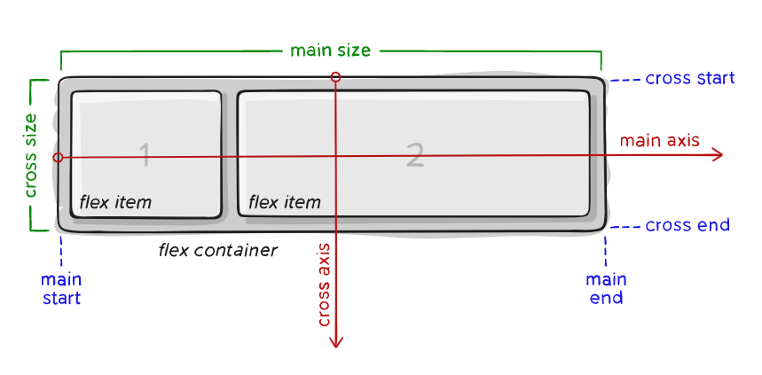
Basic Terminology

Slide 5
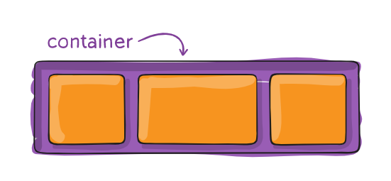
Properties for the Parent ( flex container )
display: flex;
flex-direction: row | row-reverse | column | column-reverse;
justify-content: flex-start | flex-end | center | space-between | space-around;
align-items: stretch | flex-start | flex-end | center | start | end; flex-wrap: nowrap | wrap | wrap-reverse;

Slide 6
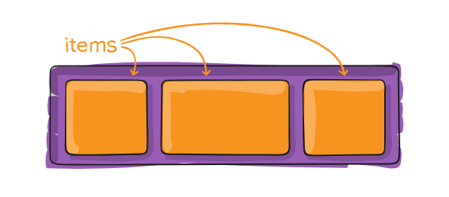
Properties for the Child ( flex items )
order: 5;
/* default is 0 */
flex-grow: 4;
/* default is 0 */
align-self: auto | flex-start | flex-end | center | stretch;

Slide 7
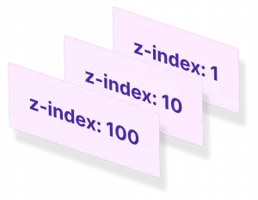
Z-index
Prerequisite
Position property other than static
It is particularly useful when dealing with overlapping elements on a web page.
By default z-index is auto

Slide 8
Background
background-color
background-image: url(“...path…”);
background-repeat: repeat | repeat-x | repeat-y| no-repeat | space | round
background-attachment: scroll | fixed | local
background-position
background-clip: border-box | padding-box | content-box
background-origin: padding-box | border-box | content-box
background-animation

Slide 9
Overflow

Slide 10
Gradient

Slide 11


Slide 12
Resources
Flexbox
Z-index
Gradient
Background
Overflow

Slide 13
Assignment

Slide 14
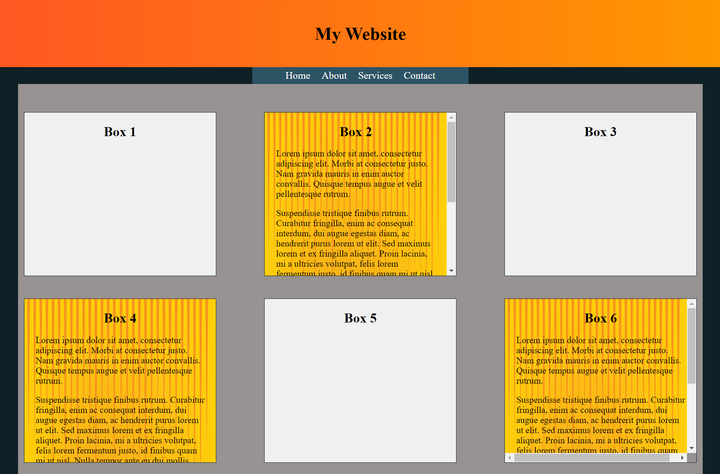

Slide 15
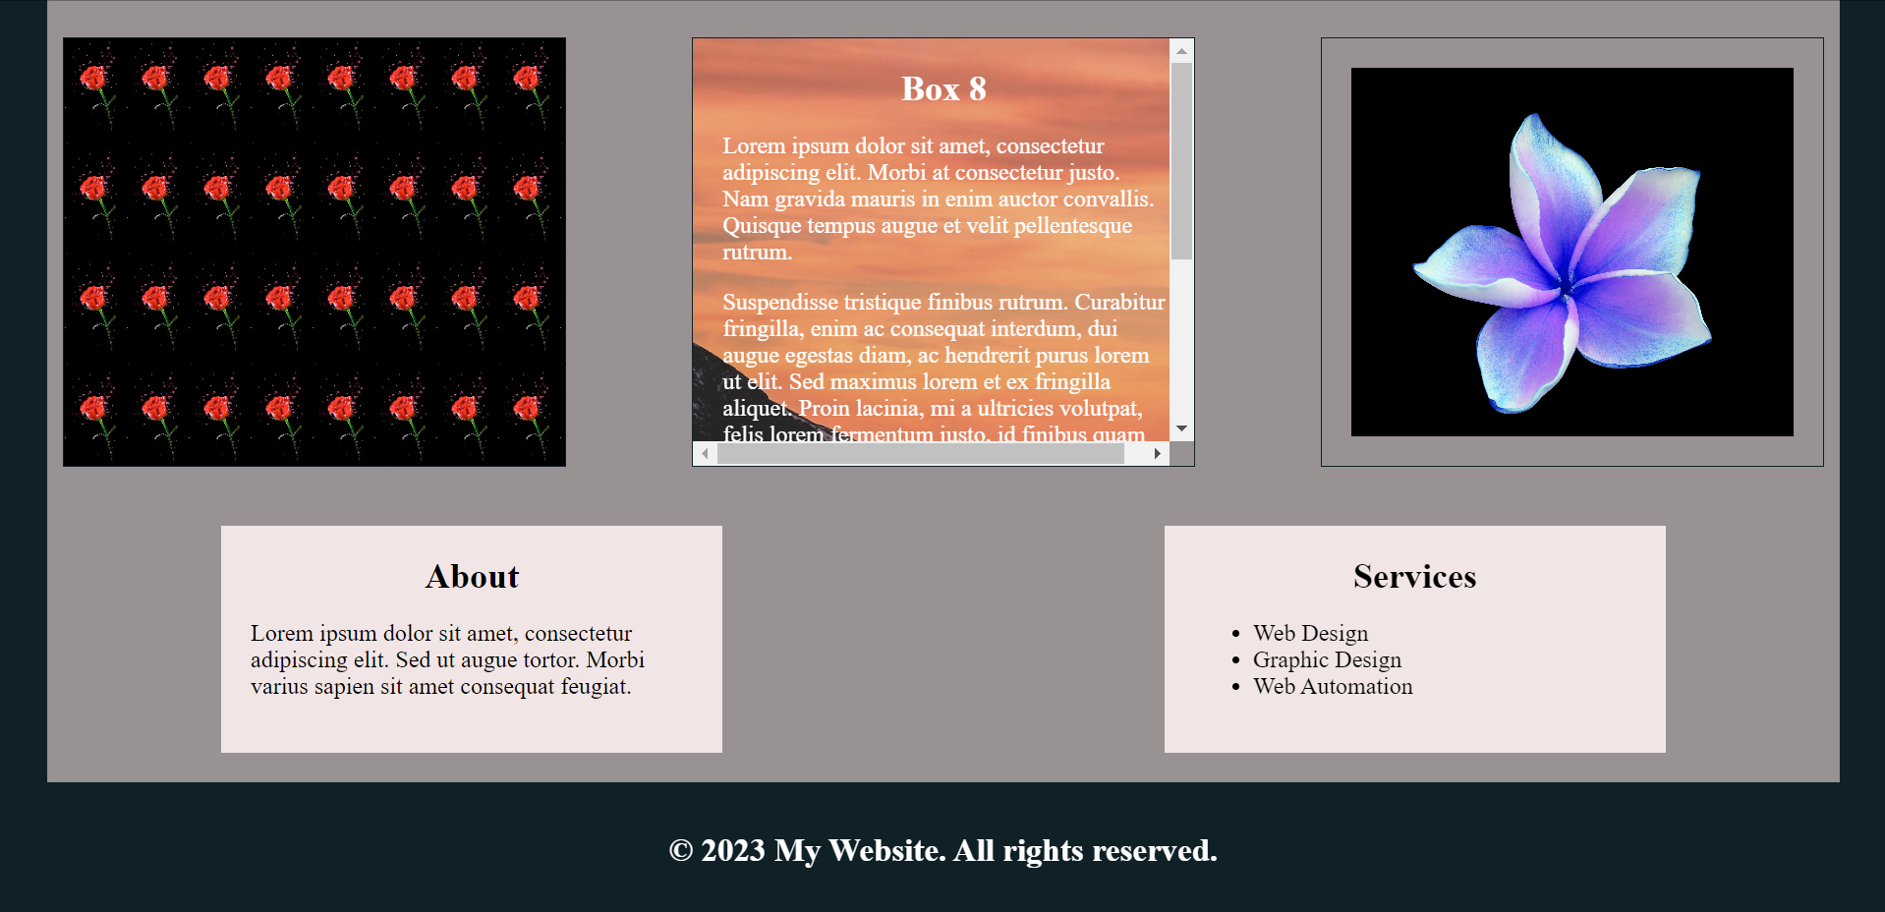

Slide 16
Thank You

